Slide 1
PROGRAMMING
LESSON
This is where your journey begins

Slide 2
TABLE OF CONTENTS
01
03
02
04
PROGRAMMING BASICS
PYTHON AND ITS BASICS
PROGRAMMING LANGUAGE STRUCTURE
CALCULATION WITH PYTHON

Slide 3
01
PROGRAMMING BASICS

Slide 4
ABOUT THIS TOPIC
In this topic we would discuss about the basics of programming and its uses.

Slide 5
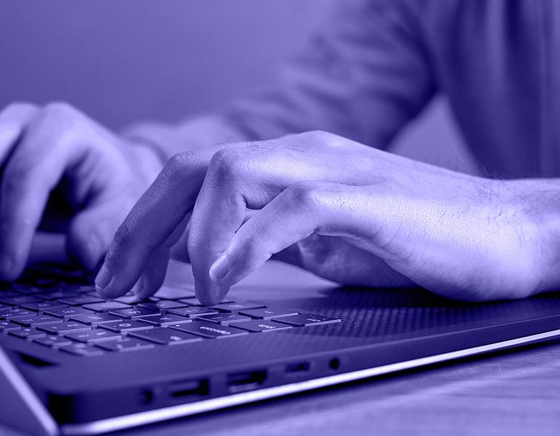
What is programming? Something Magical?
Computer Programming is a step by step process of designing and developing various sets of computer programs to accomplish a specific computing outcome. The process comprises several tasks like analysis, coding, algorithm generation, checking accuracy and resource consumption of algorithms, etc. The purpose of computer programming is to find a sequence of instructions that solve a specific problem on a computer.

Slide 6
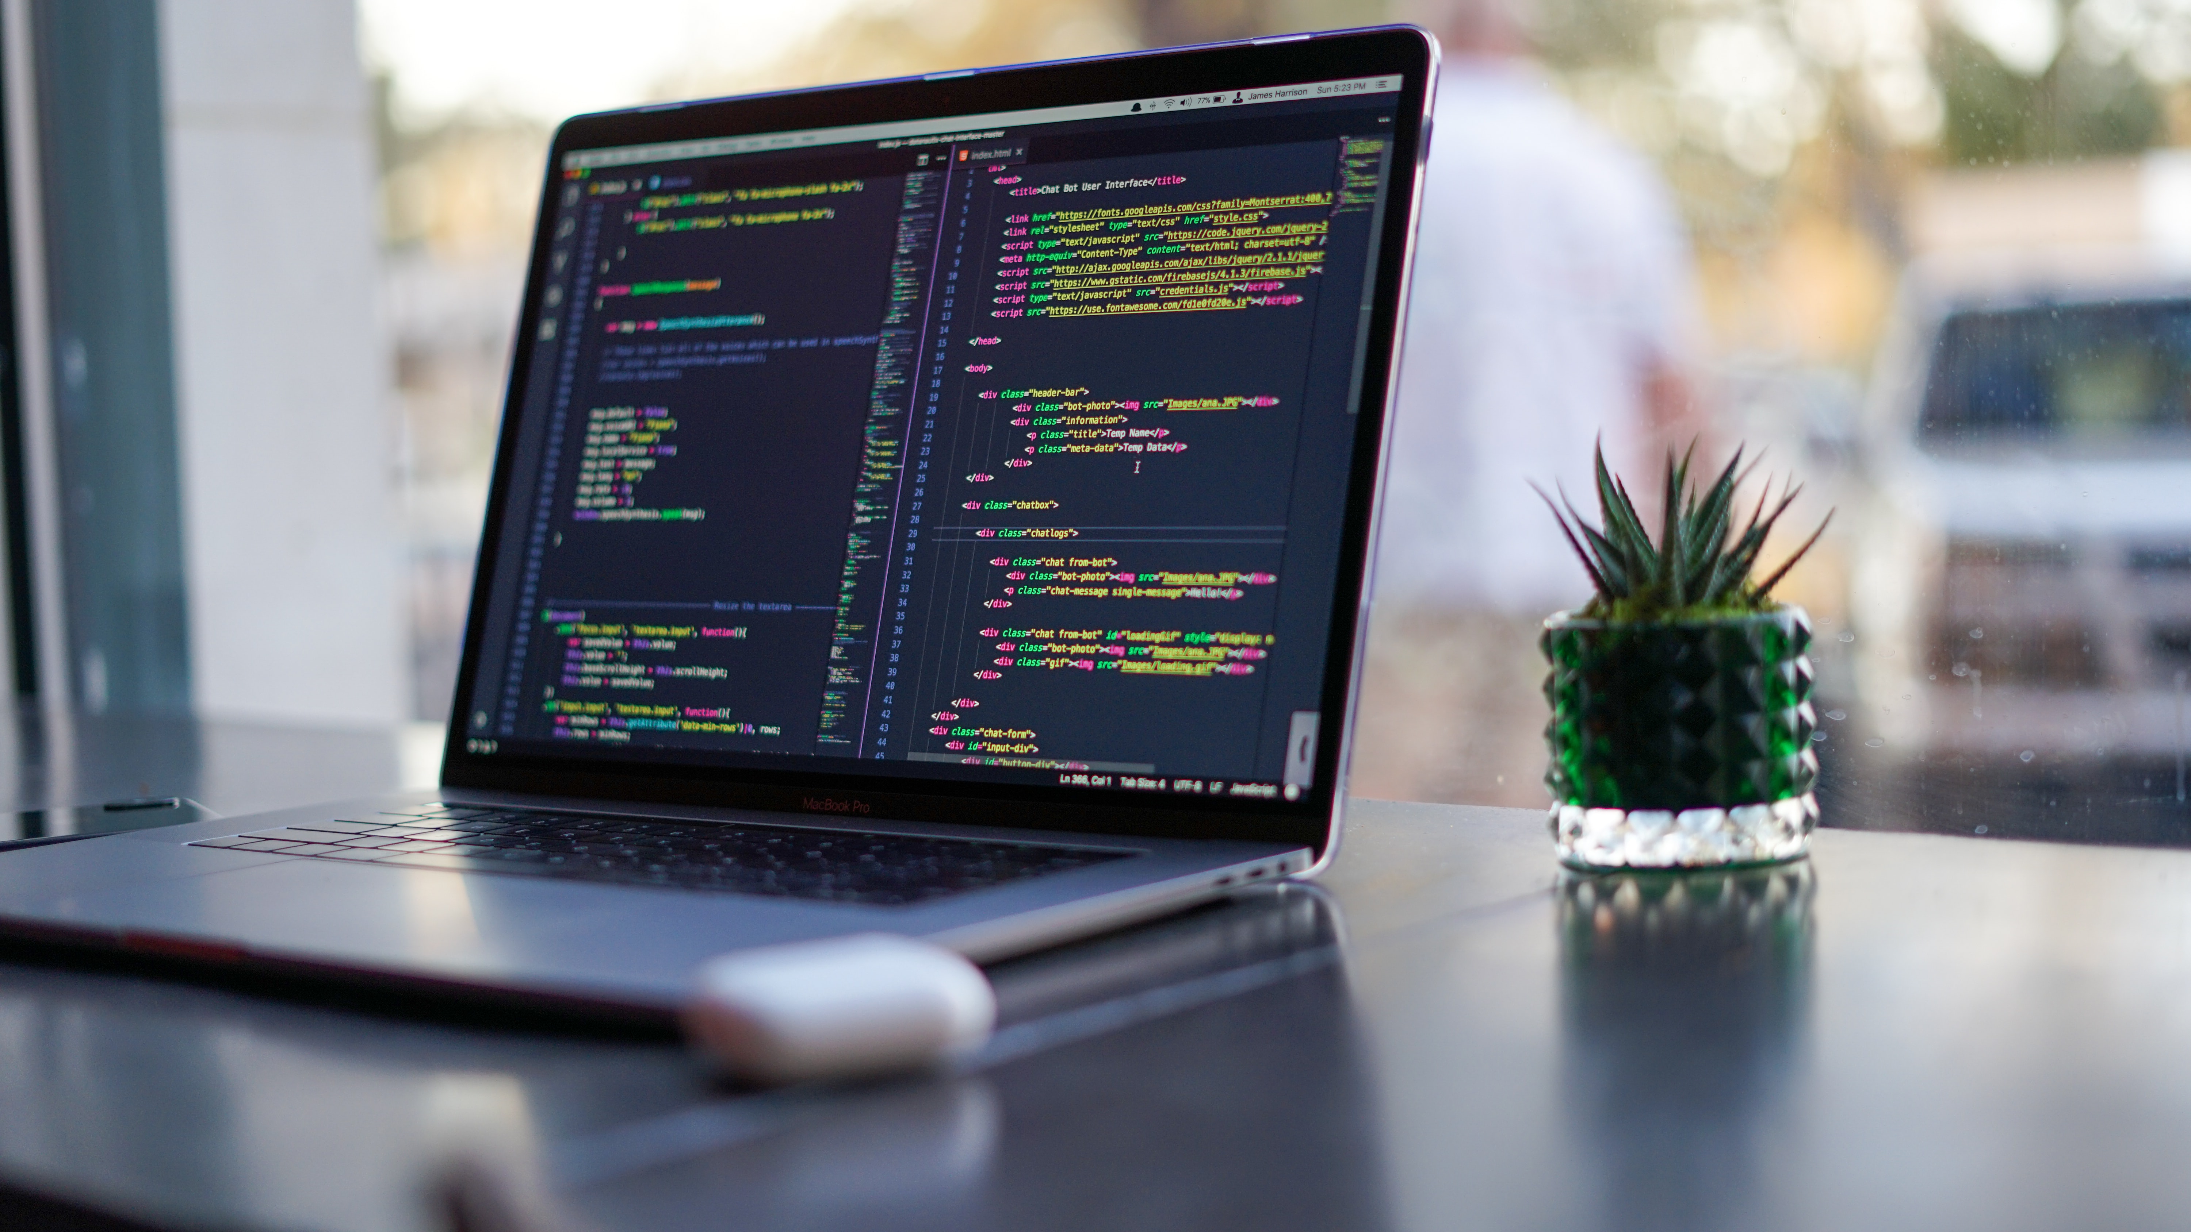
Some types of programming languages
Interpreted Languages
Compiled Languages
Assembled Languages
Object Oriented Languages
Function Oriented languages
Low level
High level

Slide 7
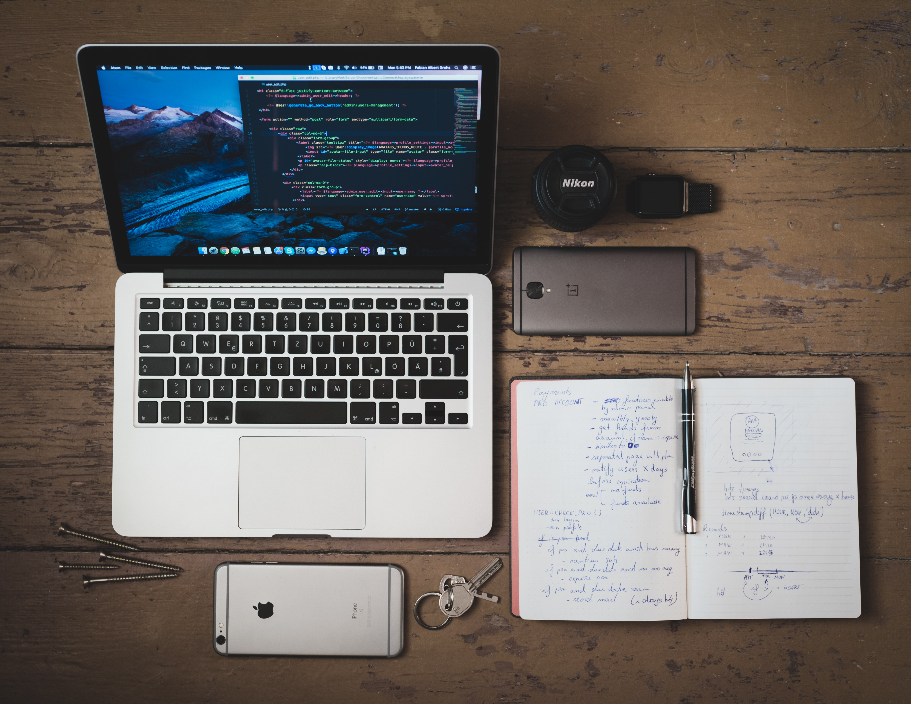
Basic Components of Programming languages
Variables – Constants, Declarations etc.
Operators – And, Or, Not, Nor, Xor etc.
Statements – If, Switch etc.
Loops – While, For, Do while etc.
Syntax – The actual structure of the code
Operands – Equals, um that’s it
Functions – toString(), .kill() etc.
Data Types – String (Text), Number, Array etc.
You will be taught more about these in lesson number two

Slide 8
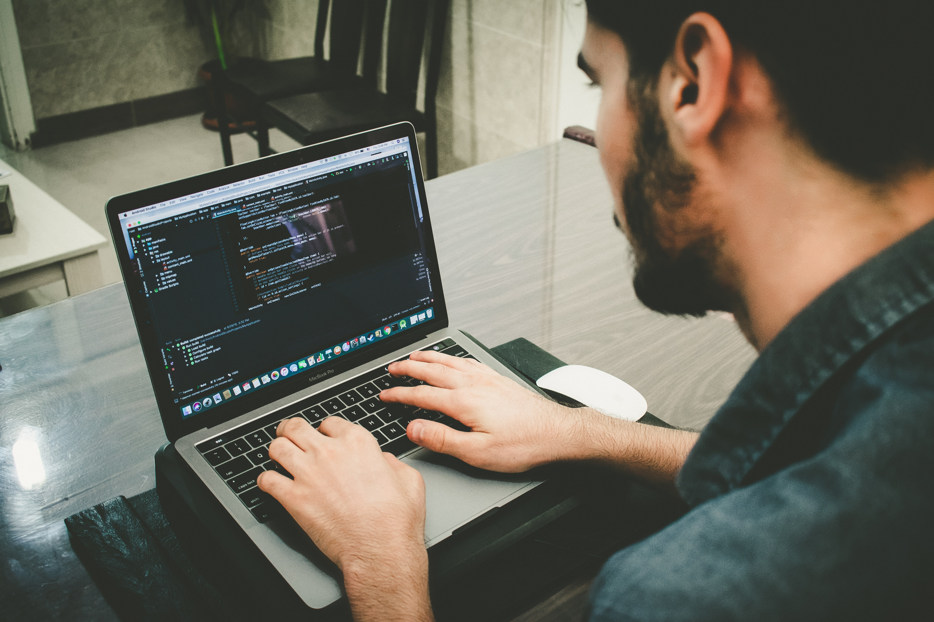
Uses of programming
Programming is used in every bit of our daily lives, Games? Websites? This Projector you are seeing this from? Laptop? Programming is everywhere you will not be able to imagine the modern world without it.

Slide 9
02
PROGRAMMING LANGUAGE STRUCUTURE

Slide 10
ABOUT THIS TOPIC
In this topic we will discuss the basic programming languages. Their structure and syntax.

Slide 11
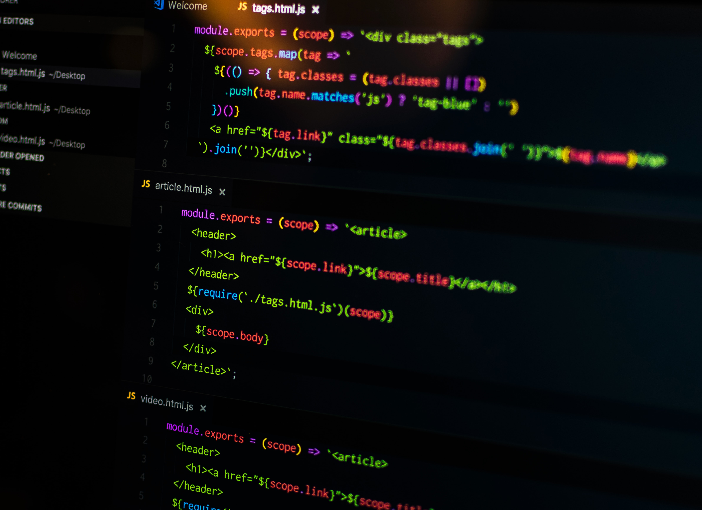
Few modern programming languages
Python (I’m sure all of you hear about it)
It is an Interpreted, High level, Object Oriented Language.
Java (Yes the one in which Minecraft is made)
It is a compiled, High level, Object Oriented Language
C (No not the letter)
It is a compiled, Low level, Functional Langauage

Slide 12
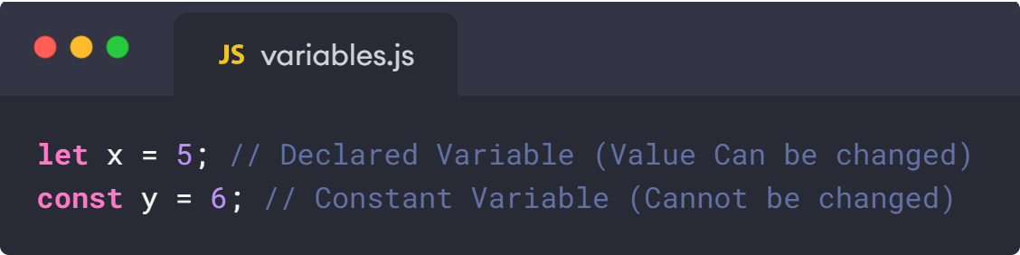
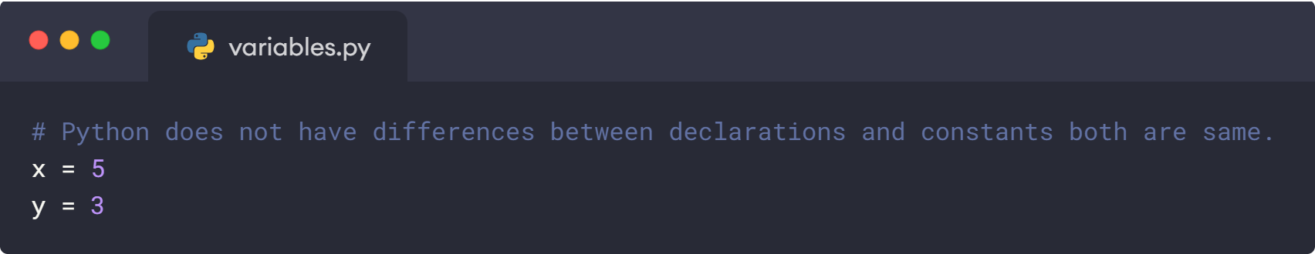
Variables
Variables are blocks of information stored in your device’s memory (RAM) which can be used over and over. They can be declarations which can be changed or constants which cannot be changed.

Slide 13
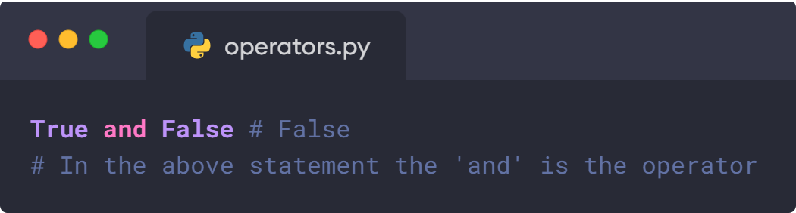
Operators
Operators are basic computer features which are based on logic gates and allow you to check the status of variables.
In order to learn about operators in depth, some programming knowledge is needed which will be taught in lesson number two.

Slide 14
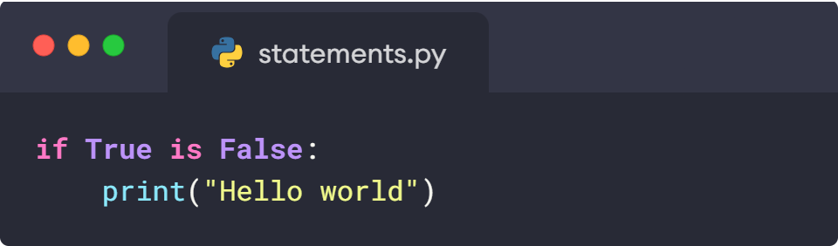
Statements
Statements are logical English like sentences used to compare quantities, you will be taught more about this in the next lesson (Lesson number 3)

Slide 15
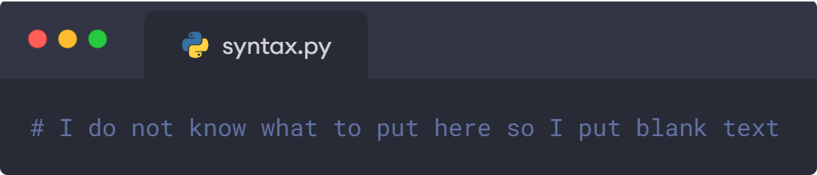
Syntax
The syntax of a programming language is the set of rules that define which arrangements of symbols comprise structurally legal programs -and for each structurally legal program, what its structure actually is.
It is just like grammar in English.

Slide 16
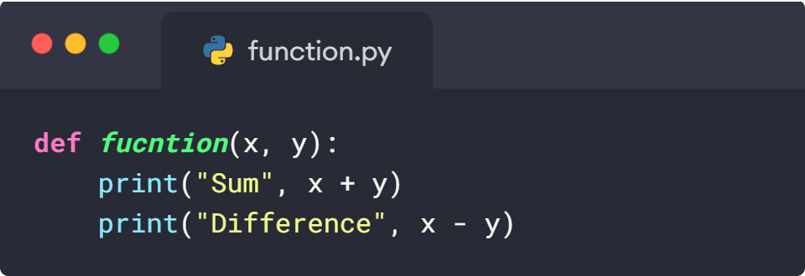
Functions
Functions are blocks of code which can be used over and over in code without having to retype them, Just like polynomials in math.
You will be taught more about this later in the sessions.

Slide 17
03
PYTHON AND ITS BASICS

Slide 18
ABOUT THIS TOPIC
In this topic we will discuss the basic syntax of Python and some of its history.
(I’m sure no one is interested in history)

Slide 19
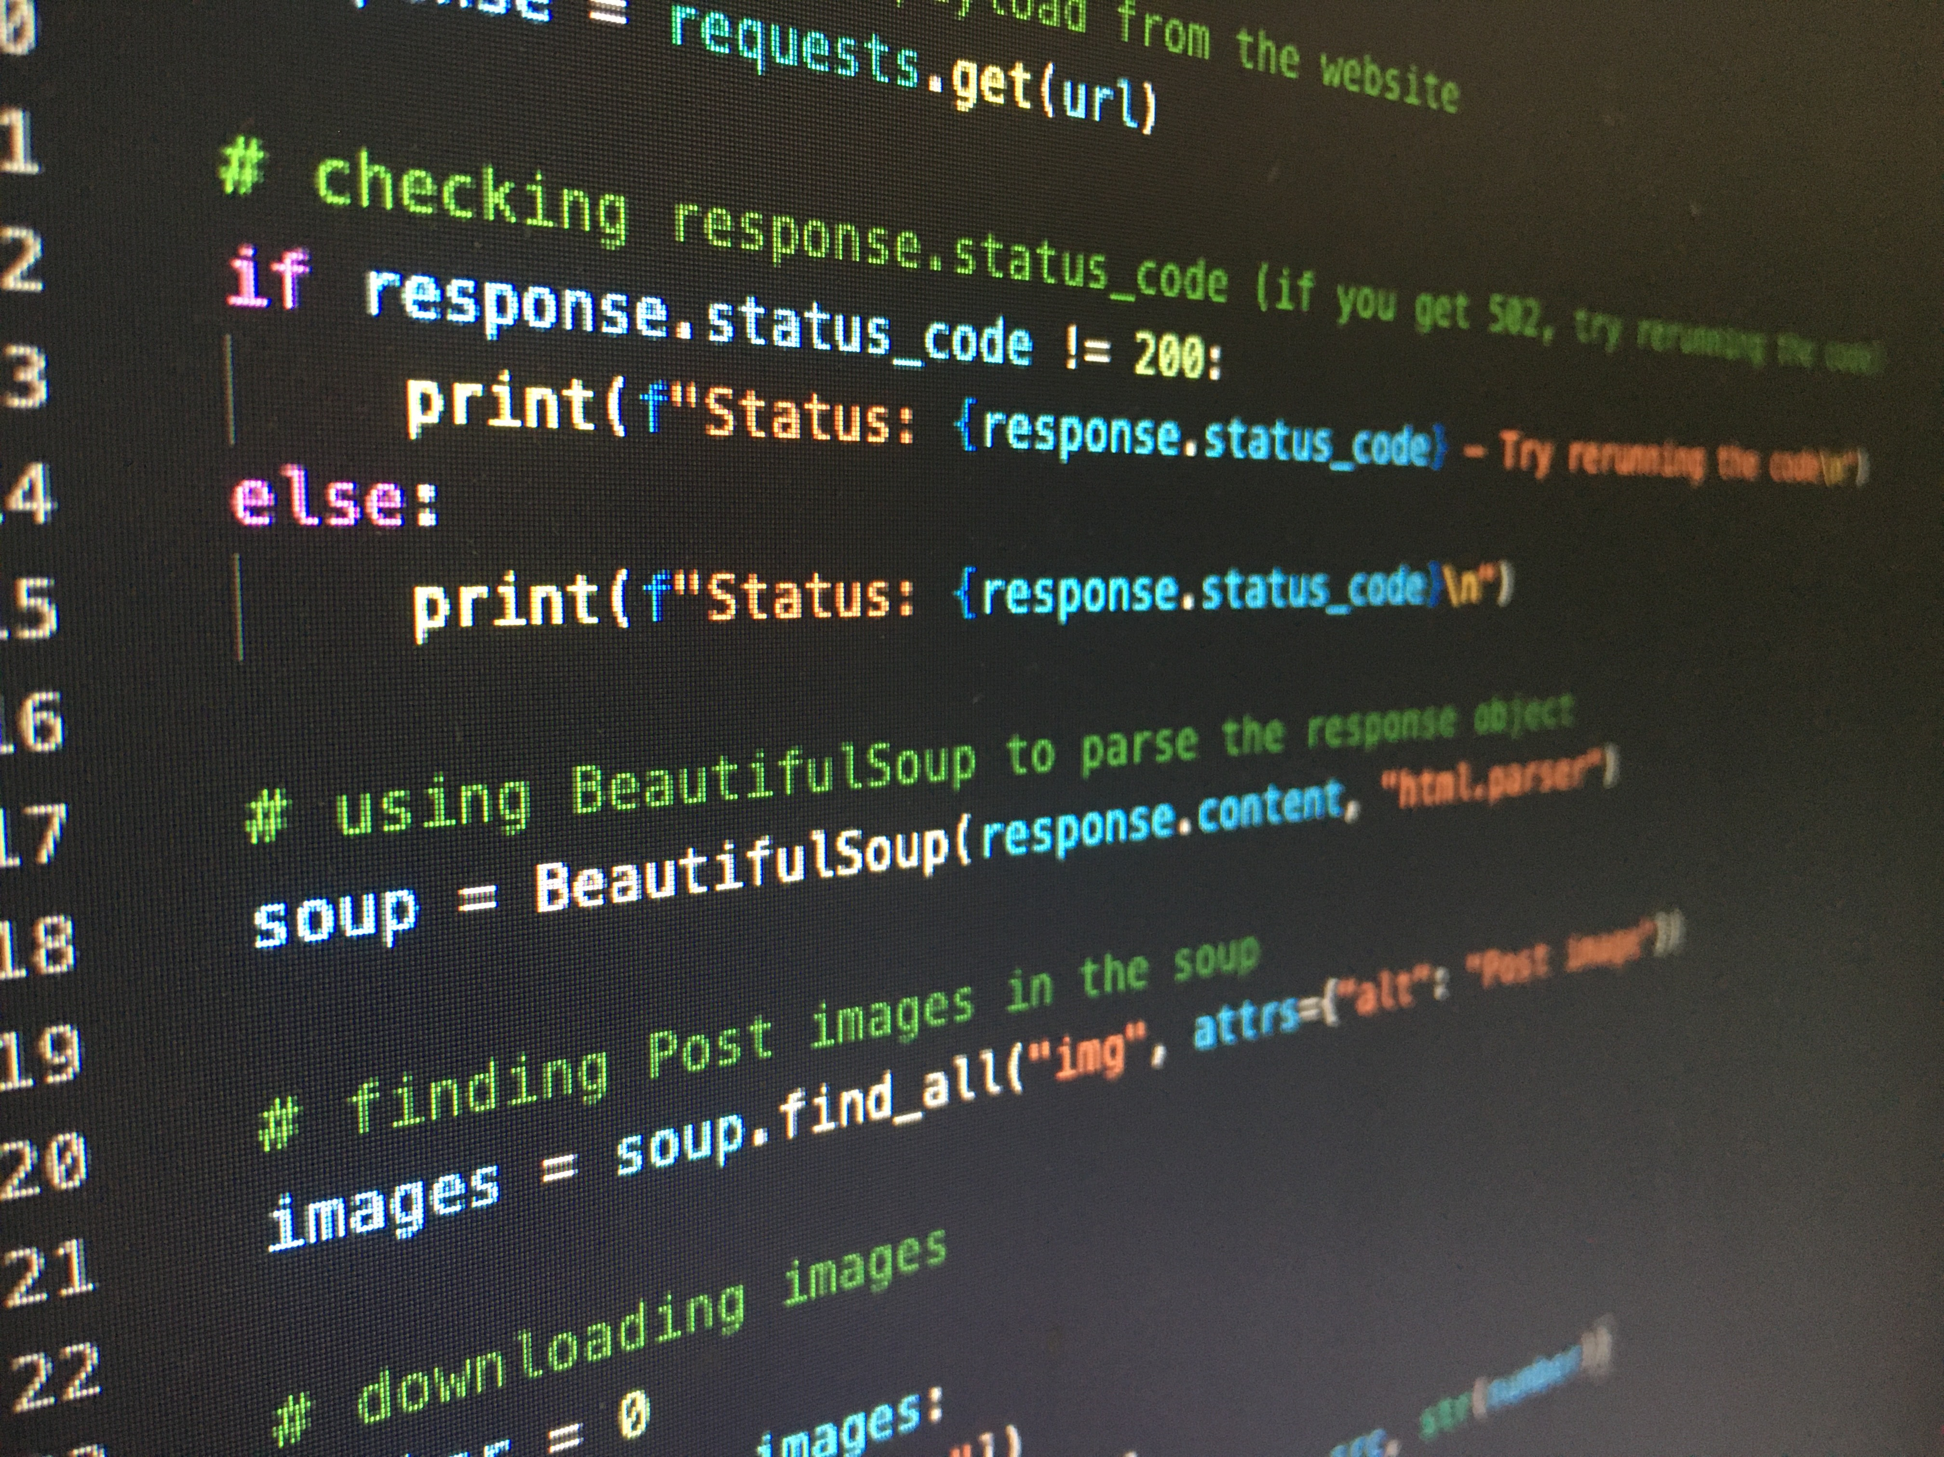
What is python? A snake?
Well, no. Python is a high-level, interpreted, general-purpose programming language. Its design philosophy emphasizes code readability with the use of significant indentation.
Python is dynamically-typed and garbage-collected.
Guido van Rossum began working on Python in the late 1980s as a successor to the “ABC” (weird name I know) programming language and first released it in 1991 as Python 0.9.0. Python 2.0 was released in 2000 and introduced new features such as list comprehensions, cycle-detecting garbage collection, reference counting, and Unicode support. Python 3.0, released in 2008, was a major revision that is not completely backward-compatible with earlier versions. Python 2 was discontinued with version 2.7.18 in 2020.

Slide 20
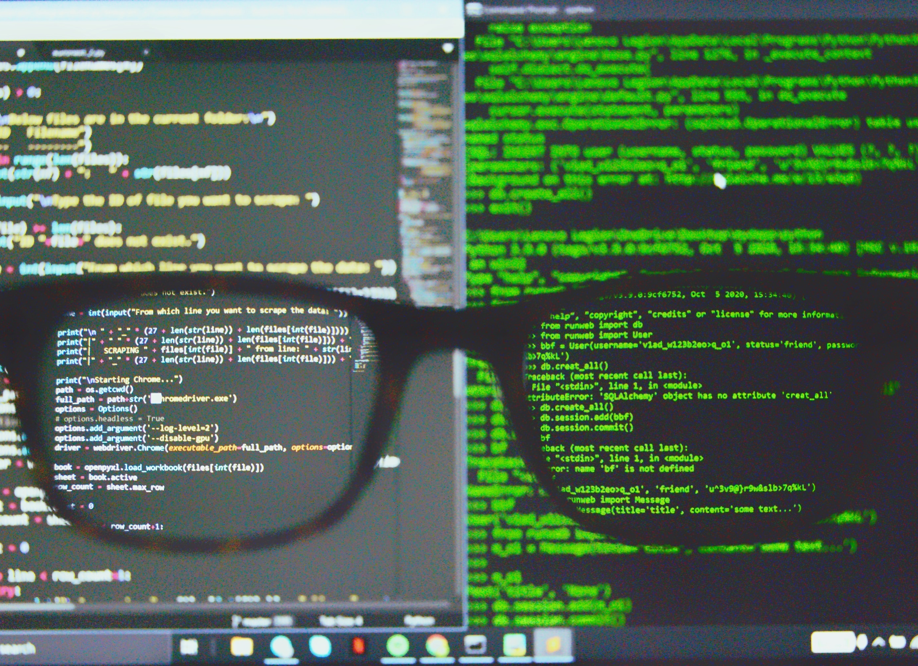
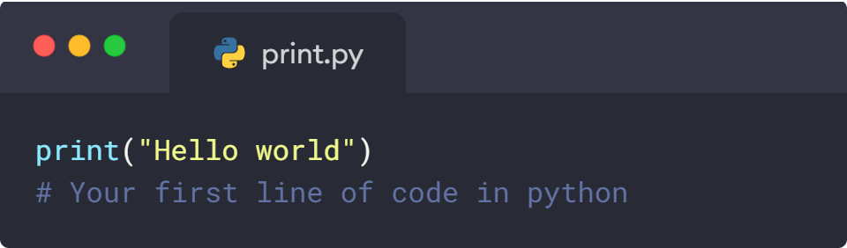
Print Statement, the basic of programming
The print statement in python is the most basic of all the statements in python, it is used to print or display text to the console. In simpler words, to show the text to the person running the program.

Slide 21

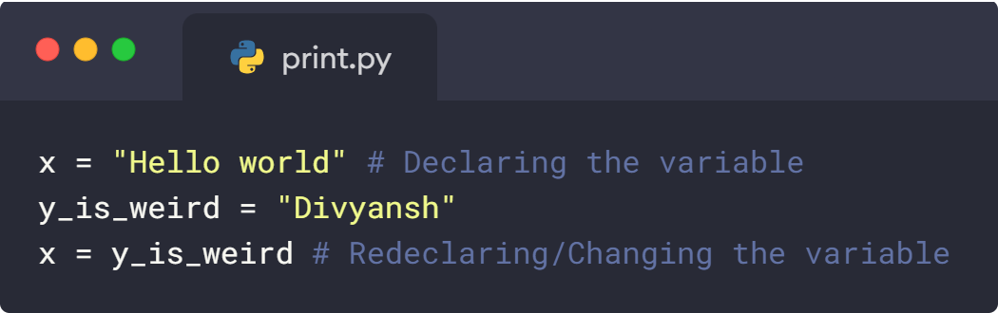
Variables in Python
Variables in python are just like variables in mathematics, they can be set to any data type within python. They can be used within python again and again without changing

Slide 22
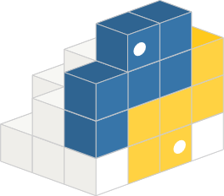
PyPI and pip
PyPI and pip are tools used within python to use the code made available to everyone by other people. (https://pypi.org/user/Div_100 - shameless self promotion) Some famous PyPI projects are Pandas, OpenCV, NumPY, Tensorflow etc.

Slide 23
IN ADDITION TO THIS YOU WILL BE TAUGHT CALCULATION IN PYTHON IN NEXT LESSON

Slide 24
04
CALCULATION WITH PYTHON
Phew! that took a long time

Slide 25
ABOUT THIS TOPIC
In this topic you will be taught about calculations in python.

Slide 26
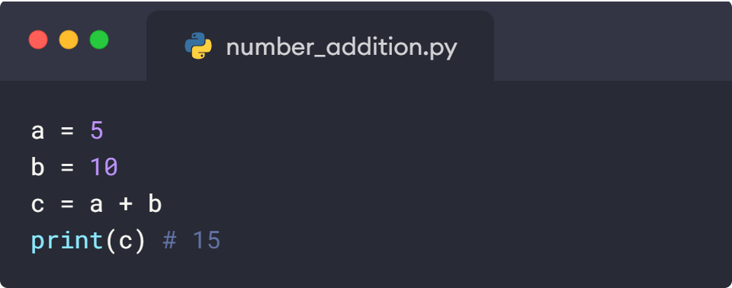
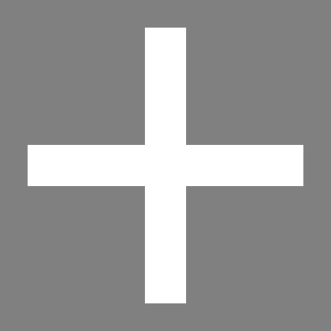
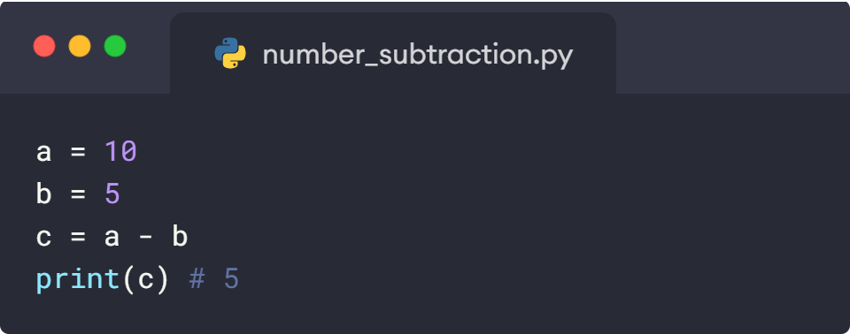
Addition & Subtraction of numbers
Addition in python is done with the “+” Symbol.

Slide 27
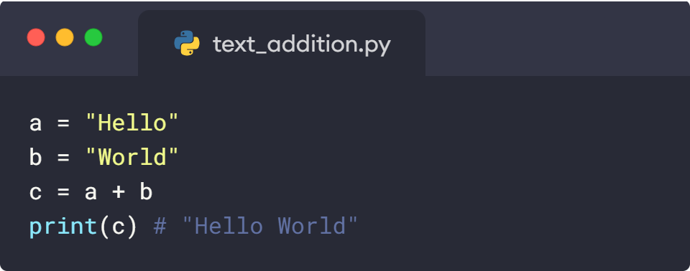
Addition of text
Addition in python is done with the “+” Symbol.

Slide 28
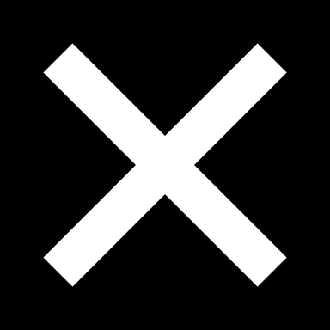
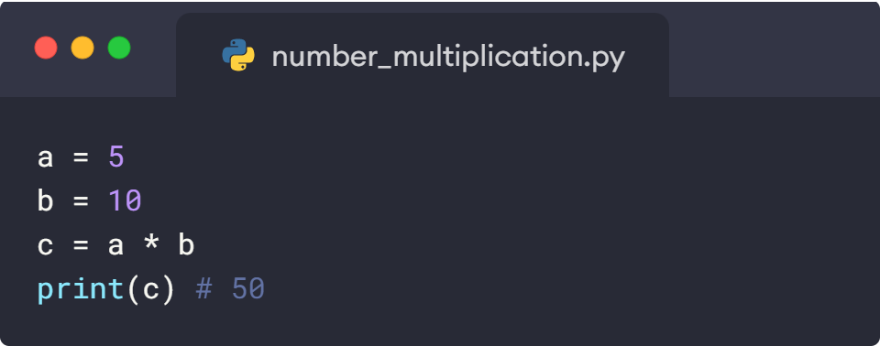
Multiplication of numbers
Addition in python is done with the “*” Symbol.

Slide 29
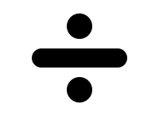
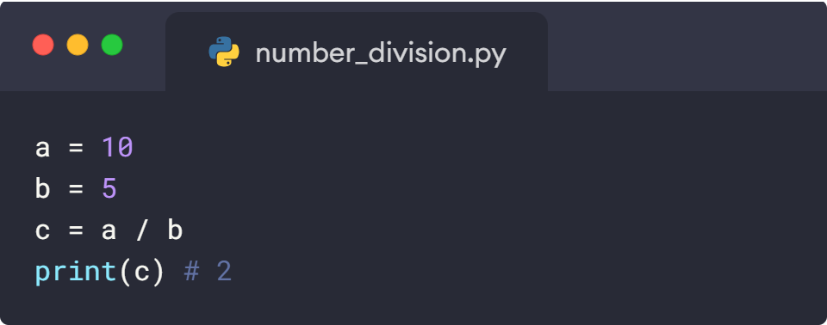
Division of numbers
Addition in python is done with the “/” Symbol.

Slide 30
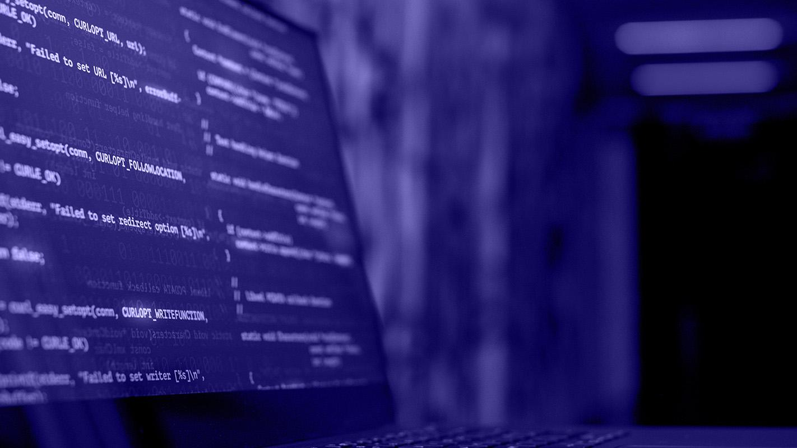
THANK YOU, THIS CONCLUDES OUR SESSION FOR TODAY.

